Slide 1
Secure PIN-Based Smart Relay Control System Using ESP32 and Web Dashboard.

Slide 2
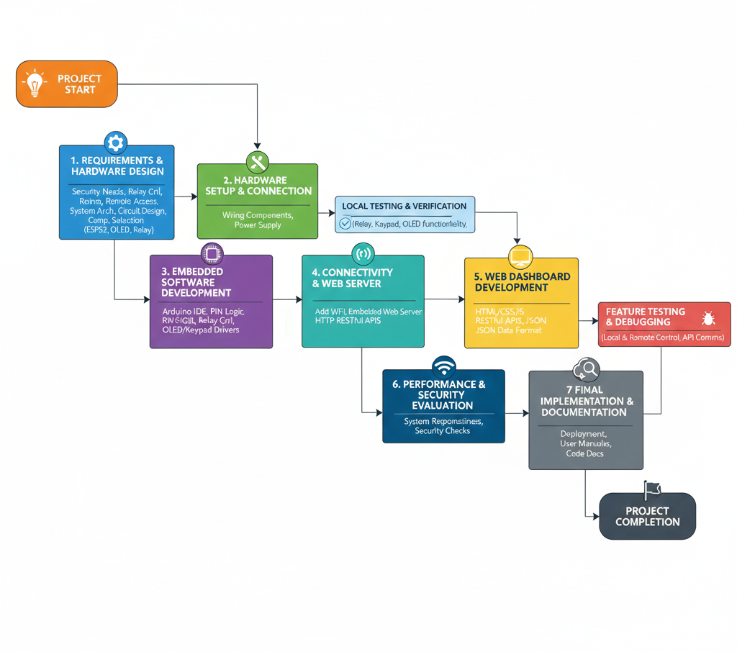
Project Methodology (Flowchart)

Slide 3
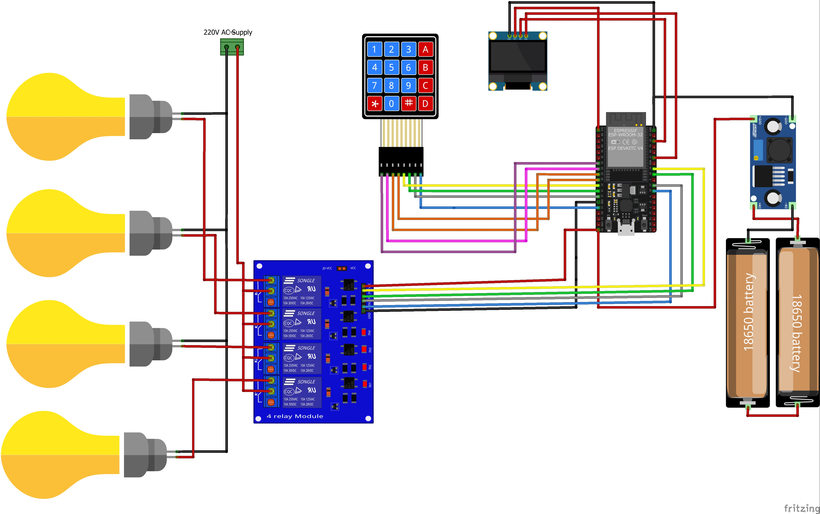
System Design

Slide 4
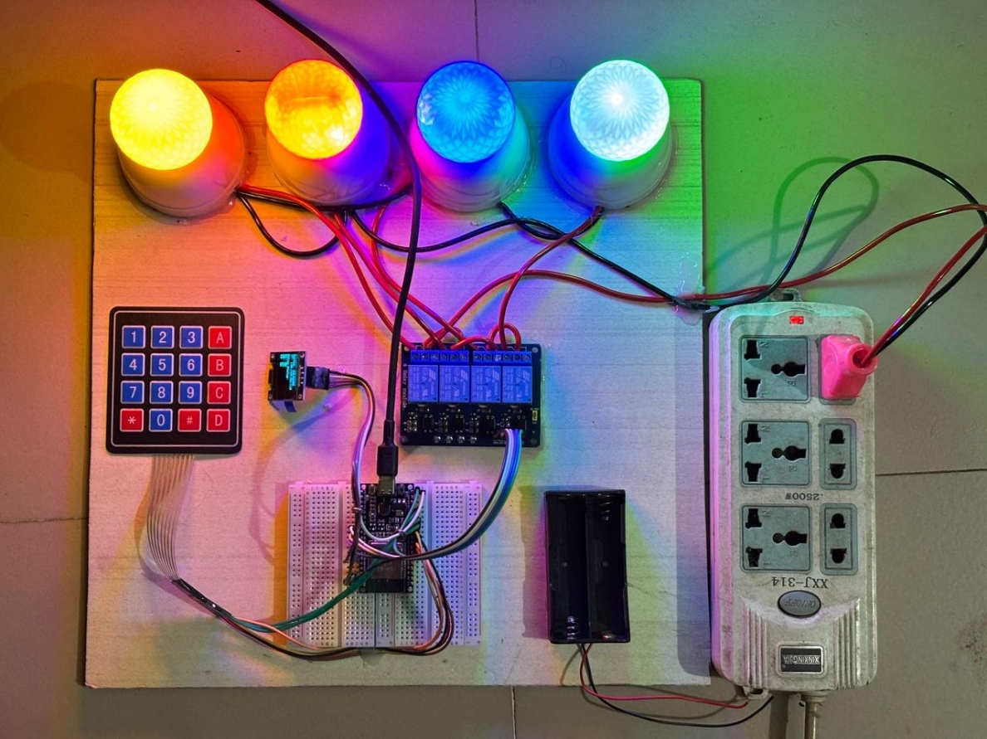
Result and performance analysis
System response time is fast.
Stable Wi-Fi connectivity.
Accurate relay switching.
Authentication prevents unauthorized access.
OLED and web dashboard provide real-time feedback.
System operates reliably under repeated testing.

Slide 5
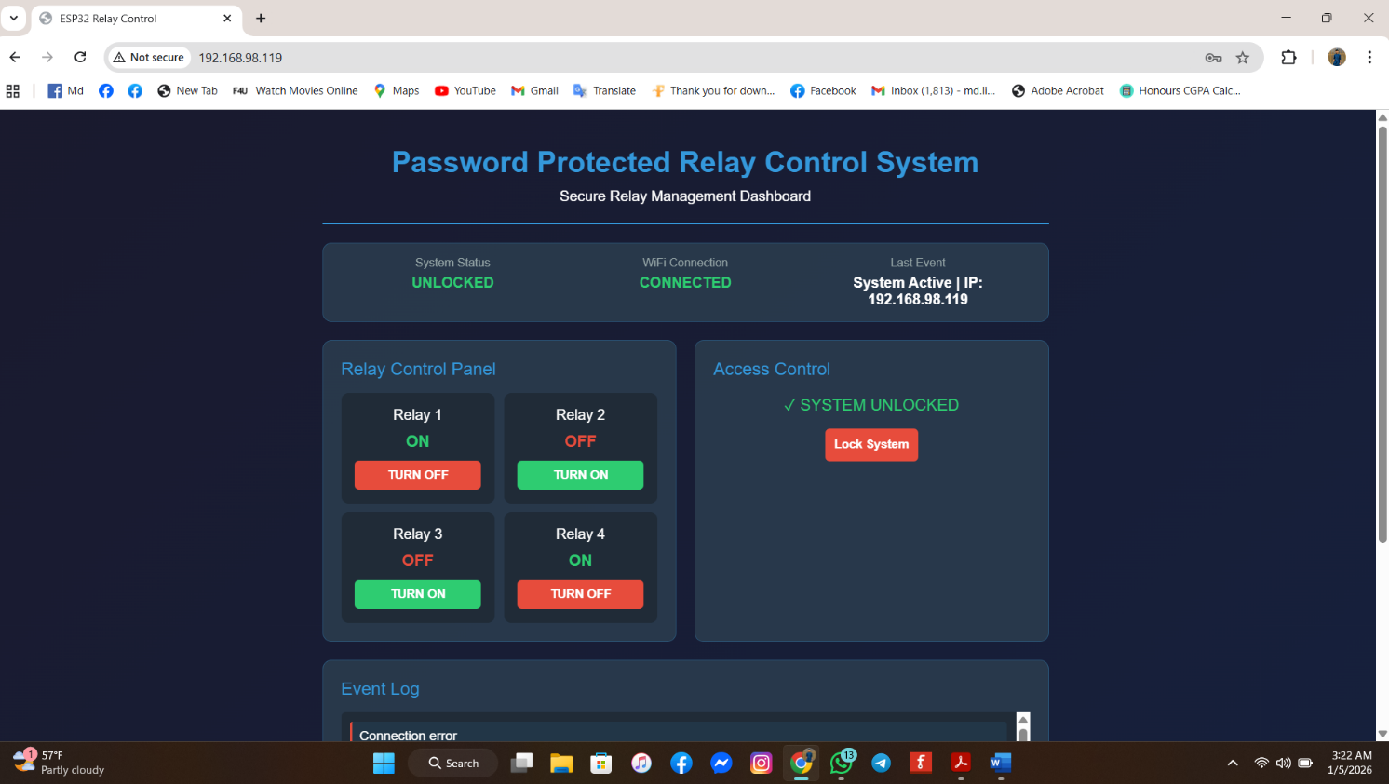
Result and performance analysis
Real‑time relay ON/OFF status displayed
Secure PIN‑based access confirmed
Fast response to user commands
Stable Wi‑Fi communication observed
Accurate relay switching without delay
User‑friendly and simple web interface
System status visible anytime, anywhere

